Slide 1

Time series adversarial attack and defense
Karlsruhe Institute for Technology
Xue Zhechang

Slide 2
Outline
Motivation
Adversarial attack methods
Defense
Conclusion

Slide 3
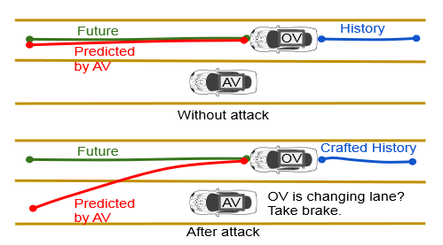
Motivation
Example: Self-Driving
Time series
Deep learning models
Adversarial attack

Slide 4
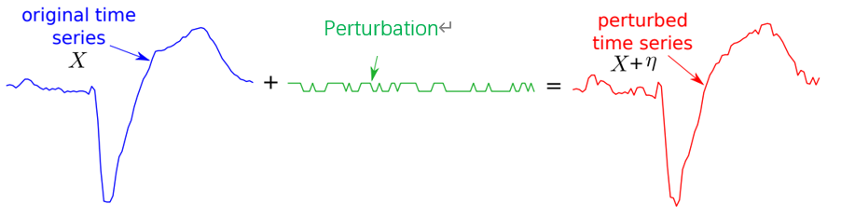

Adversarial attack methods
X ′ = X + η
White-box attacks
Fast gradient sign method
Basic iterative method
Black-box attacks
Random noise attack
Boundary attack

Slide 5
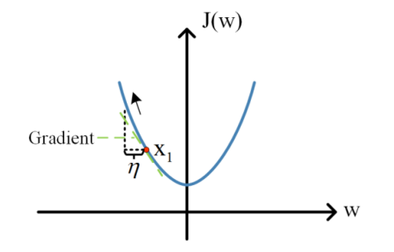
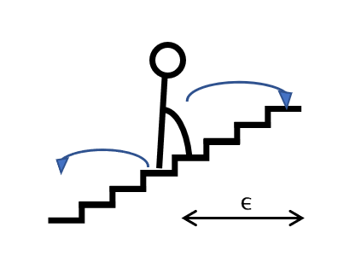
Fast gradient sign method (FGSM)
One-step gradient update
η = ϵ · sign(∇͓ L(X, Y ))
ϵ is the magnitude of the perturbation
L(X, Y) is the loss function corresponding to the sample X

Slide 6
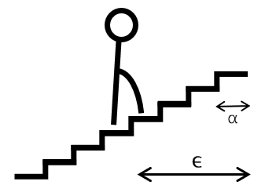
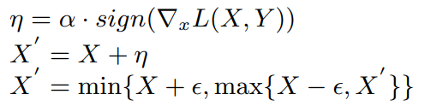
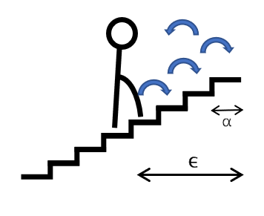
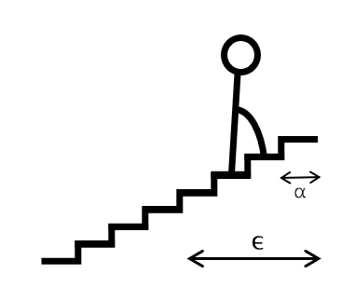
Basic iterative method (BIM)
Iterate in smaller step sizes
α is the per-step small perturbation
ϵ is the amount of maximum perturbation
I is the number of iterations.

Slide 7
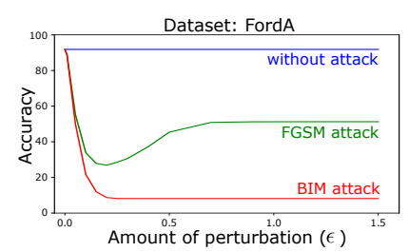
FGSM v.s. BIM
 | Generating time | Effect on accuracy
FGSM | Short | Less effective
BIM | Long | Effective

Slide 8
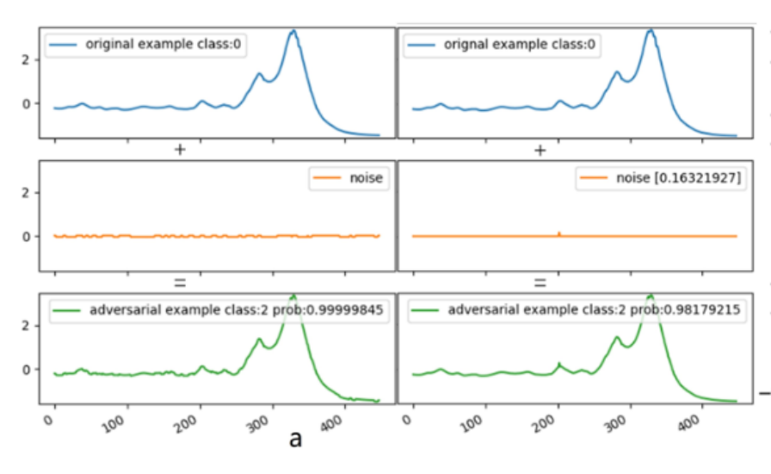
Random noise attack
Generating random noise data
Even a tiny perturbation can misguide the decision of the model

Slide 9
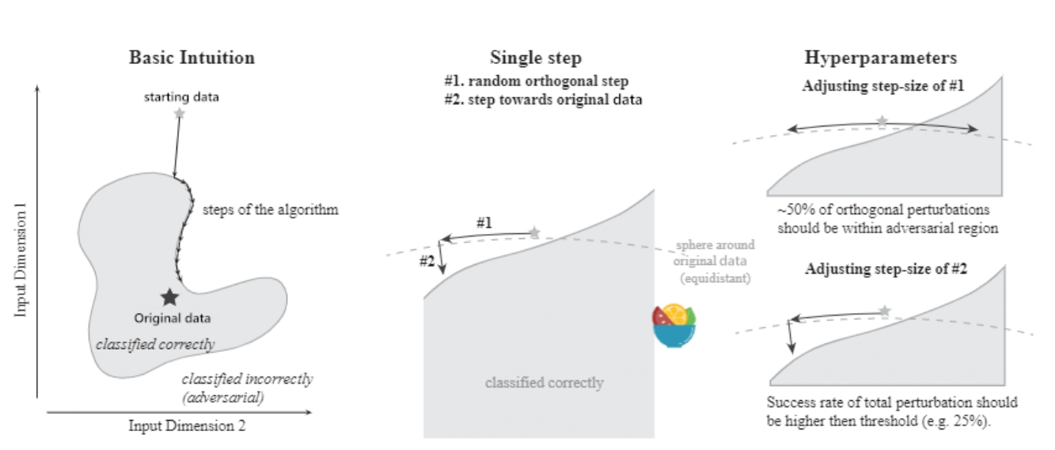

Boundary attack
Get the whole decision boundary of the label of the original data.
Is it necessary to modify the whole original time series?

Slide 10
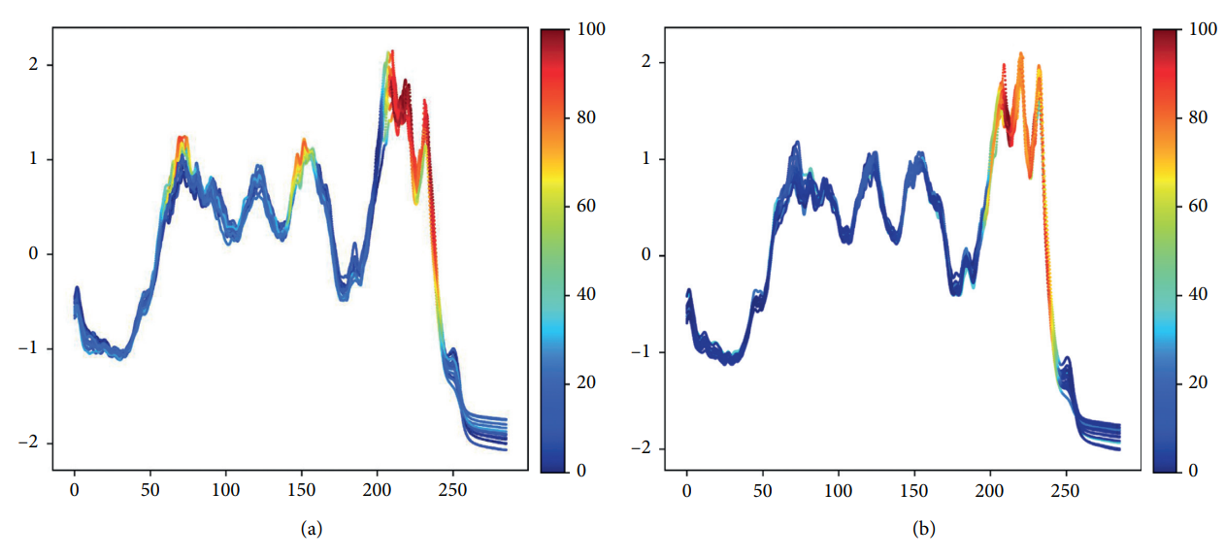
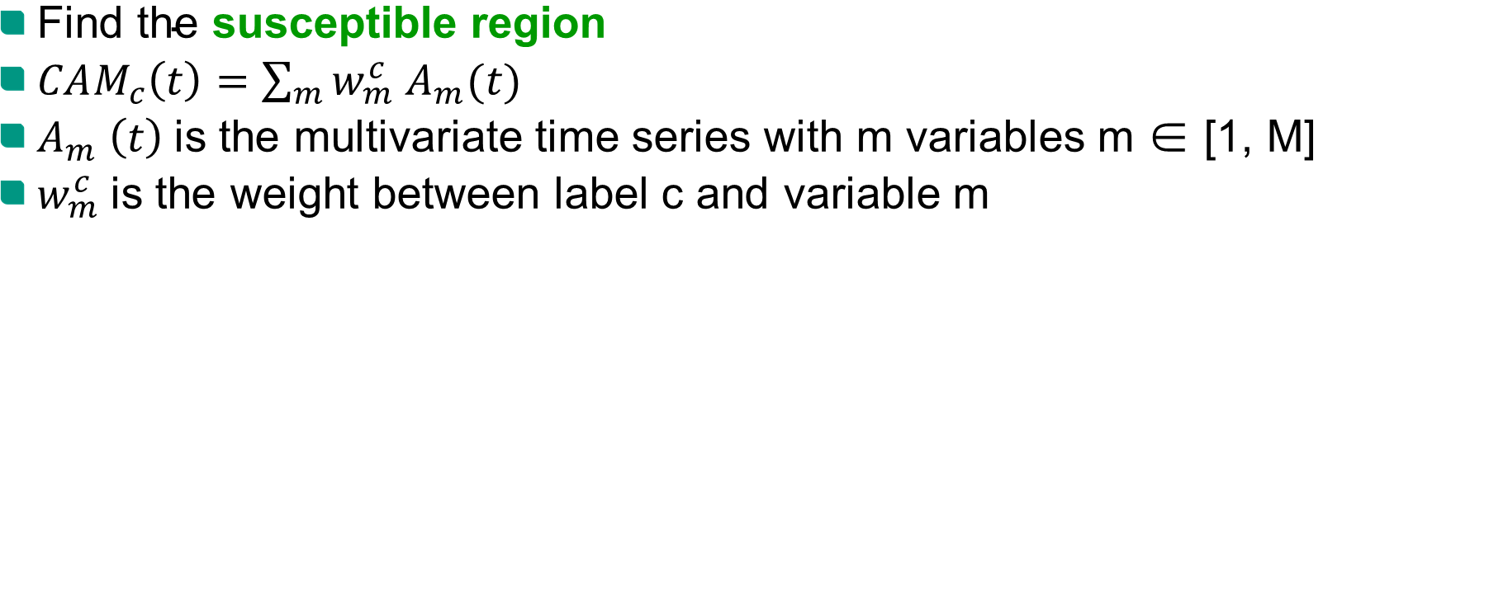
Class activation map
$\text{Find} \text{the} \text{susceptible} \text{region}$
$CAM_{c}\left(t\right)=\sum_{m}{w_{m}^{c} A_{m}(t)}$
$A_{m} \left(t\right)$is the multivariate time series with m variables m ∈ [1, M]
$w_{m}^{c}$is the weight between label c and variable m

Slide 11
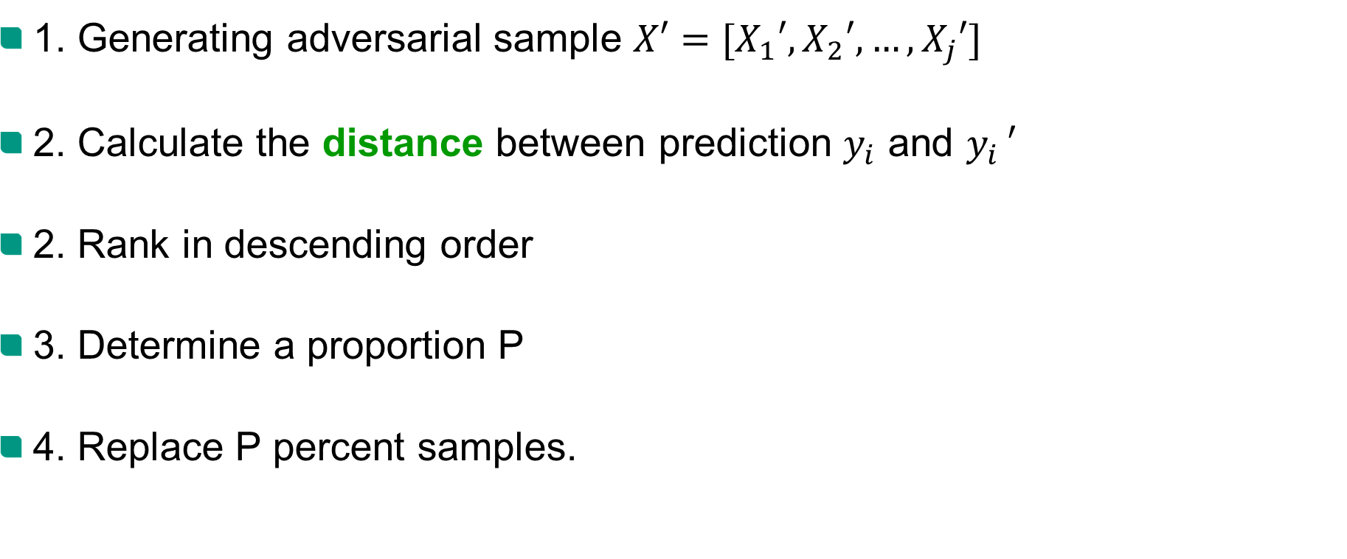
The importance of adversarial sample
1. Generating adversarial sample $X′=[X_{1}′,X_{2}′, …,X_{j}′]$
2. Calculate the distance between prediction $y_{i}$ and $y_{i }′$
2. Rank in descending order
3. Determine a proportion P
4. Replace P percent samples.

Slide 12
Defense
Adversarial training
Feature denoising
Non-linear transfer
Thermometer coding
Encode-decode model

Slide 13
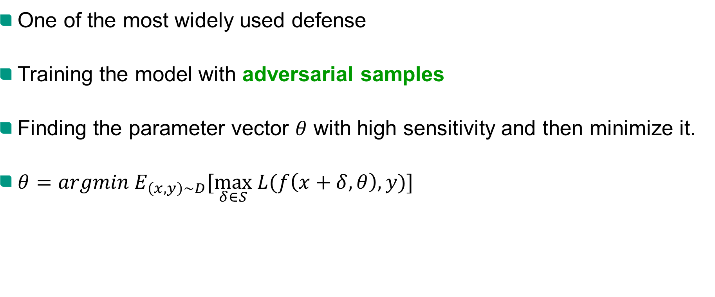
Adversarial training
One of the most widely used defense
Training the model with adversarial samples
Finding the parameter vector $θ$ with high sensitivity and then minimize it.
$θ=argmin E_{\left(x,y\right)\sim D}[\max_{δ∈S} L(f\left(x+δ, θ\right), y)]$

Slide 14
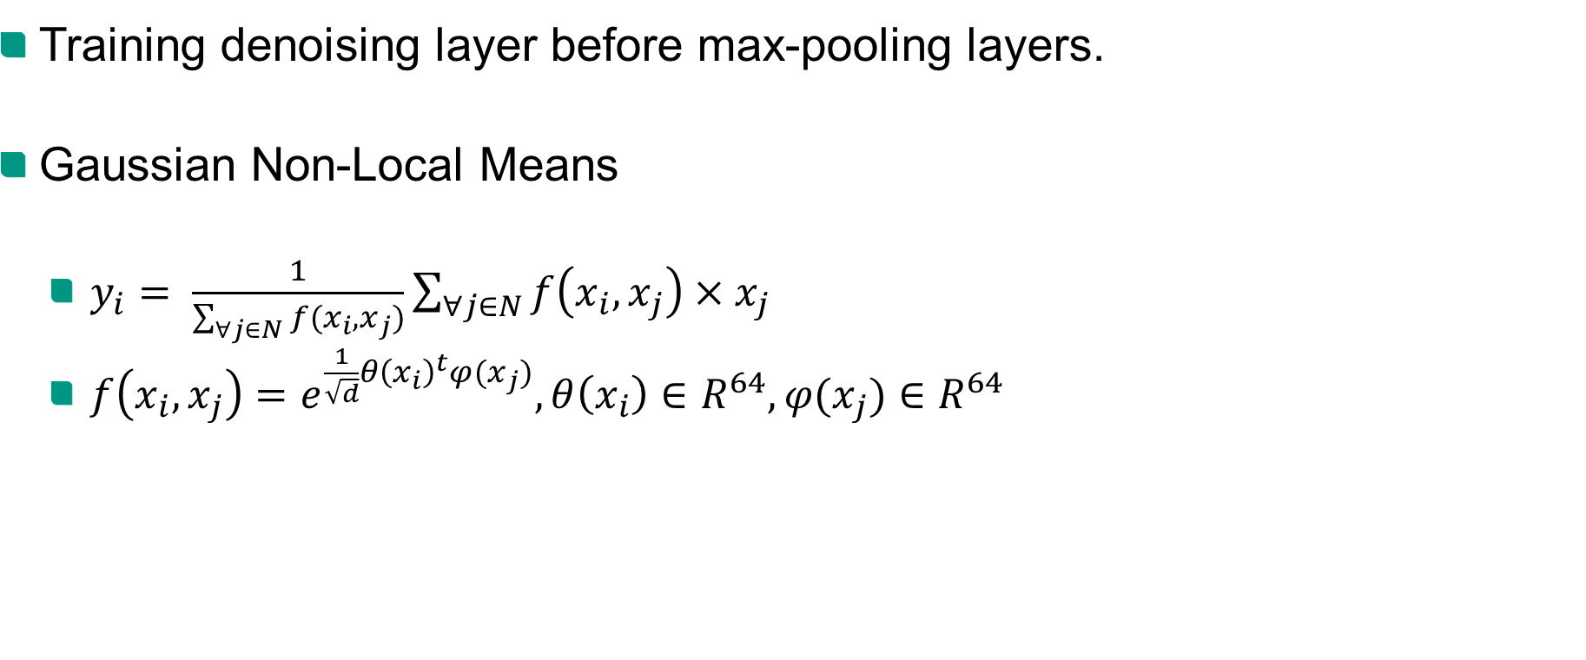
Feature denoising
Training denoising layer before max-pooling layers.
Gaussian Non-Local Means
$y_{i}= \frac{1}{\sum_{∀j∈N}{f(x_{i}, x_{j})}}\sum_{∀j∈N}{f\left(x_{i}, x_{j}\right)×x_{j}}$
$f\left(x_{i}, x_{j}\right)=e^{\frac{1}{\sqrt{d}}θ{\left(x_{i}\right)}^{t}φ(x_{j})}, θ\left(x_{i}\right)∈R^{64}, φ(x_{j})∈R^{64}$

Slide 15
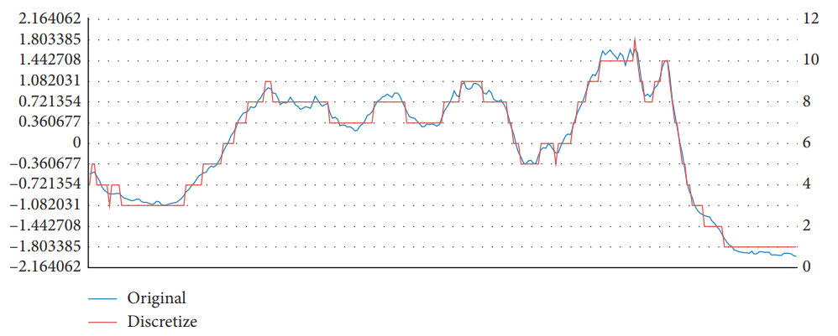
Non-linear transfer
Thermometer coding
Transfer continuous input to discrete input
Characteristic: keep the shape information of the original time series.

Slide 16
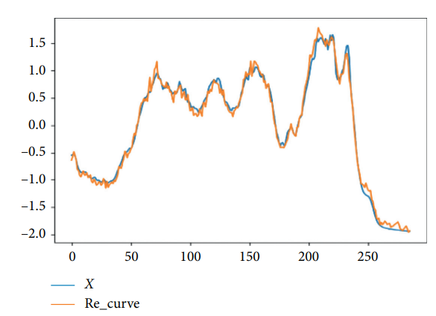
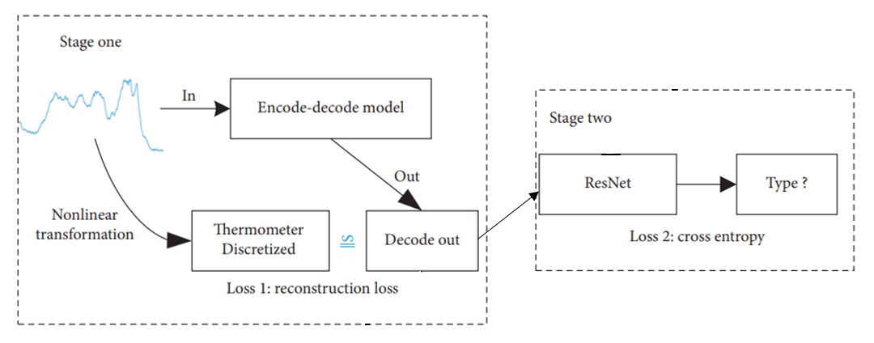
Non-linear transfer
Encode-decode model
Training this model to recover the original time series
Training time series model with decoded data

Slide 17
Conclusion

Slide 18
Thank you for your attention!

